Slide 1
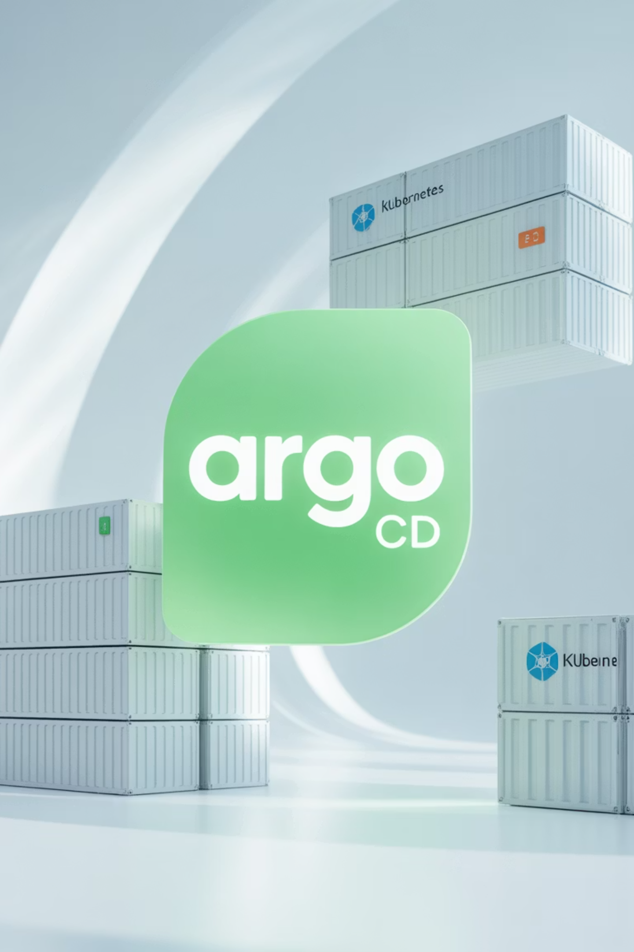
Understanding Argo CD: Kubernetes GitOps Made Simple
Welcome to this comprehensive guide on Argo CD, a Kubernetes-native continuous deployment tool that simplifies GitOps implementation. This presentation will explore how Argo CD works, its key features, installation methods, and best practices for effective adoption.

Slide 2

What Is Argo CD?
Argo CD is a Kubernetes-native continuous deployment (CD) tool that enables GitOps workflows. Unlike external CD tools that only enable push-based deployments, Argo CD can:
Pull updated code from Git repositories and deploy directly to Kubernetes resources
Manage both infrastructure configuration and application updates in one system
Automatically synchronize application state to the current version of declarative configuration
Detect and remediate configuration drift

Slide 3
Key Features of Argo CD
Deployment Options
User Interfaces
Manual or automatic deployment to Kubernetes clusters
Web user interface for visualization
Automatic synchronization of application state
Command-line interface (CLI)
Security & Management
Integration
Role-based access control (RBAC)
Support for webhooks (GitLab, GitHub, BitBucket)
Multi-cluster management capabilities
Compatibility with existing tools (YAML, Helm, Kustomize)
Single sign-on with multiple providers
These features make Argo CD a powerful tool for implementing GitOps workflows in Kubernetes environments.

Slide 4




Understanding GitOps with Argo CD
GitOps is a software engineering practice that uses a Git repository as the single source of truth for declarative infrastructure and applications.
Git Repository
Pull Requests
Contains all declarative configurations
Changes introduced via PRs
Merge to Main
Auto Deployment
Configurations merged to main branch
Changes automatically deployed
Argo CD handles the latter stages of this process, ensuring that new configurations are correctly deployed to Kubernetes clusters while maintaining a complete audit trail of all changes.

Slide 5
The Argo CD Process
At a high level, the Argo CD process works like this:
Developer makes changes to an application, pushing a new version of Kubernetes resource definitions to a Git repo
Continuous integration is triggered, resulting in a new container image saved to a registry
Developer issues a pull request, changing Kubernetes manifests
Pull request is reviewed and changes are merged to the main branch, triggering a webhook
Argo CD clones the repo and compares application state with the current state of the Kubernetes cluster
Kubernetes uses its controllers to reconcile the changes required to cluster resources
Argo CD monitors progress and reports when the application is in sync
Argo CD also monitors changes in the Kubernetes cluster and discards them if they don't match Git configuration

Slide 6
How Argo CD Makes GitOps Happen
GitOps Agent
Custom Resource Definitions (CRDs)
Command Line Interface
Pulls updated code from Git repositories and deploys directly to Kubernetes resources, managing both infrastructure configuration and application updates in one system
Powerful CLI that creates YAML resource definitions with simple commands
Extends the Kubernetes API to define application state declaratively based on Git or Helm repositories
User Interface
Multi-tenancy Support
Web-based UI for defining applications and visualizing Kubernetes configurations
Strong support for multiple teams working on different projects in the same Kubernetes environment

Slide 7
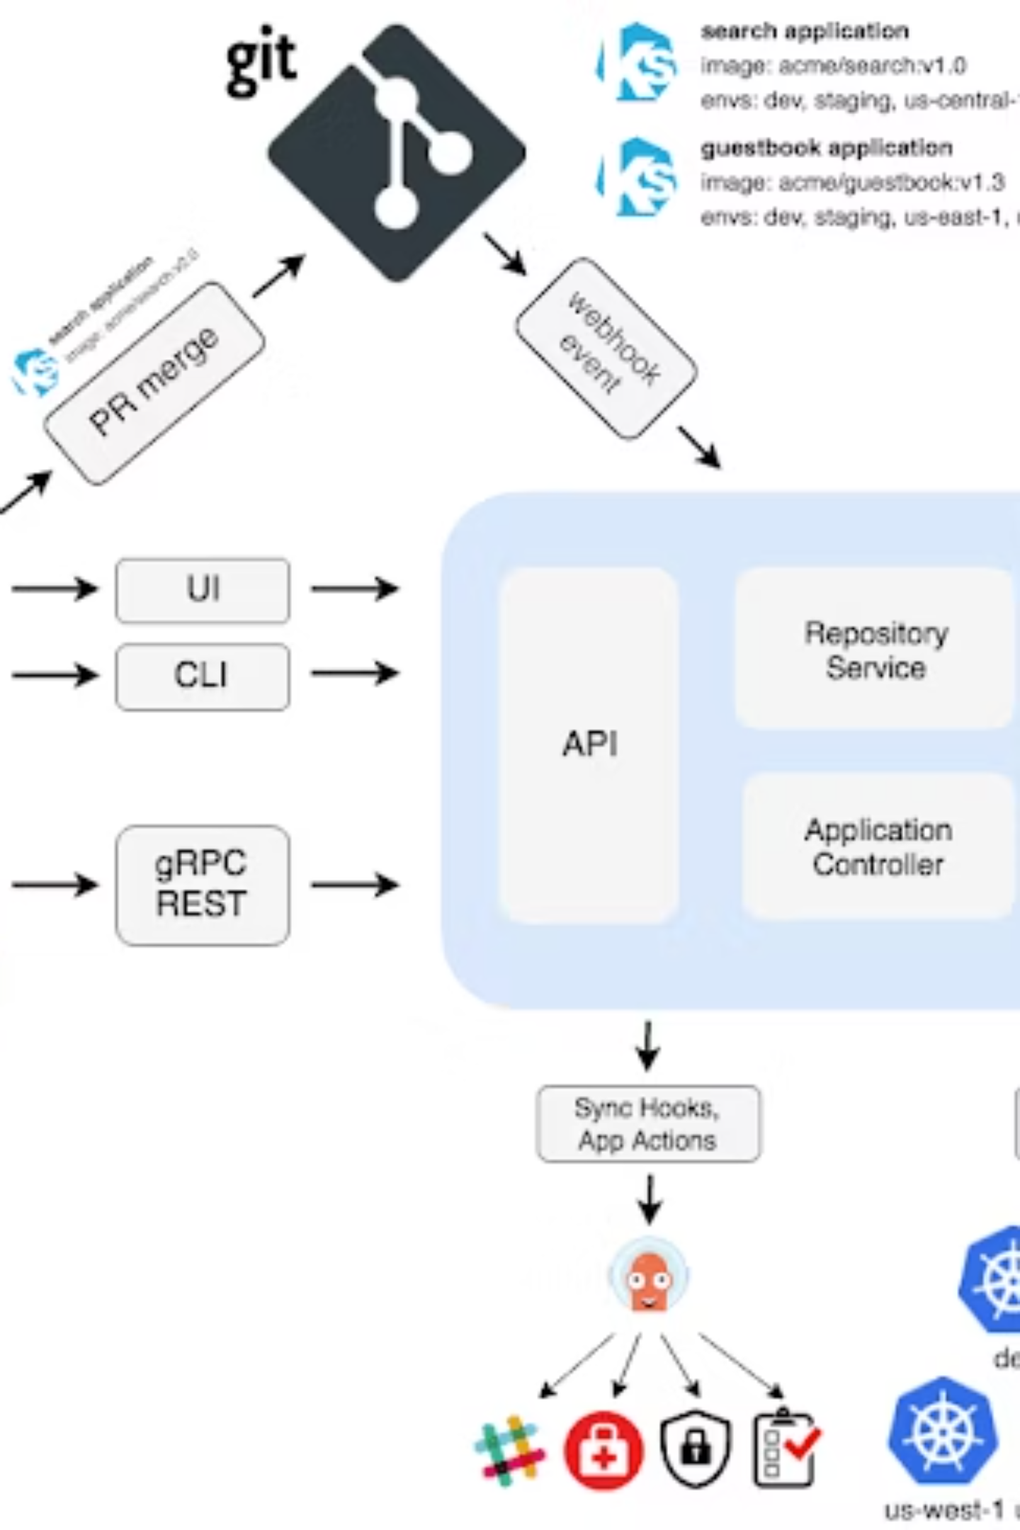
Argo CD Architecture
Argo CD is a Kubernetes controller that continuously monitors applications, comparing their live state to the desired state in Git. It identifies applications with deviations as "OutOfSync" and provides tools to reconcile these differences either manually or automatically.

Slide 8
Core Components of Argo CD
API Server
Repository Service
Application Controller
Exposes gRPC/REST API for CLI and Web UI
Caches Git repositories locally
Continuously monitors applications
Stores application manifests
Compares target state with current state
Manages applications and reports status
Generates Kubernetes manifests
Returns manifests based on repository URL, path, revisions, and template settings
Identifies OutOfSync applications
Invokes application operations (sync, rollback)
Implements corrections when specified
Manages cluster and repository credentials
Invokes user-defined lifecycle hooks
Handles authentication and authorization
Enforces RBAC policies
Processes Git webhook events

Slide 9

Expert Tips for Argo CD
1
Automate Secret Management
2
Integrate with Existing CI Pipelines
3
Implement Policy Enforcement
Integrate tools like HashiCorp Vault or AWS Secrets Manager with Argo CD to handle secrets dynamically, ensuring secure management without manual intervention.
Use Argo CD with CI tools like Jenkins or GitHub Actions to create seamless CI/CD pipelines that trigger deployments automatically when changes are pushed.
Use Open Policy Agent (OPA) with Gatekeeper to enforce policies on Kubernetes resources, ensuring all deployments adhere to organizational standards.

Slide 10

More Expert Tips
1
Utilize Argo Rollouts for Advanced Deployments
Combine Argo CD with Argo Rollouts to implement advanced deployment strategies such as blue-green, canary, or progressive delivery for more control and reduced risk.
2
Monitor Git Repositories for Security
Regularly scan Git repositories for vulnerabilities and misconfigurations using tools like Snyk or Trivy integrated into your pipeline.
These tips from Dan Garfield, VP of Open Source at Octopus Deploy, can help you maximize the benefits of Argo CD in your organization.

Slide 11

How Argo CD Works with Kubernetes Manifests
Argo CD supports multiple types of Kubernetes manifests:
Plain YAML or JSON manifests
Helm charts
Kustomize applications
Ksonnet and Jsonnet applications
Custom configuration management tools (via plugins)
Argo CD automatically deploys the desired state of an application in a specified target environment. Updates are traceable through Git commits, tags, branches, or specific versions of a manifest.

Slide 12
Argo CD Installation Methods
1
2
Core Installation
Multi-Tenant Installation
Best for cluster admins using Argo CD independently
Most popular installation type
Fewest components, easy setup
Serves multiple Dev teams
No UI or API server included
Requires platform team maintenance
Not suitable for multi-tenancy
API server allows CLI or Web UI access
Doesn't support high availability
Available in HA and non-HA versions
kubectl create namespace argocd
HA recommended for production use
kubectl apply -n argocd -f https://raw.githubusercontent.com/argoproj/argo-cd/stable/manifests/core-install.yaml

Slide 13
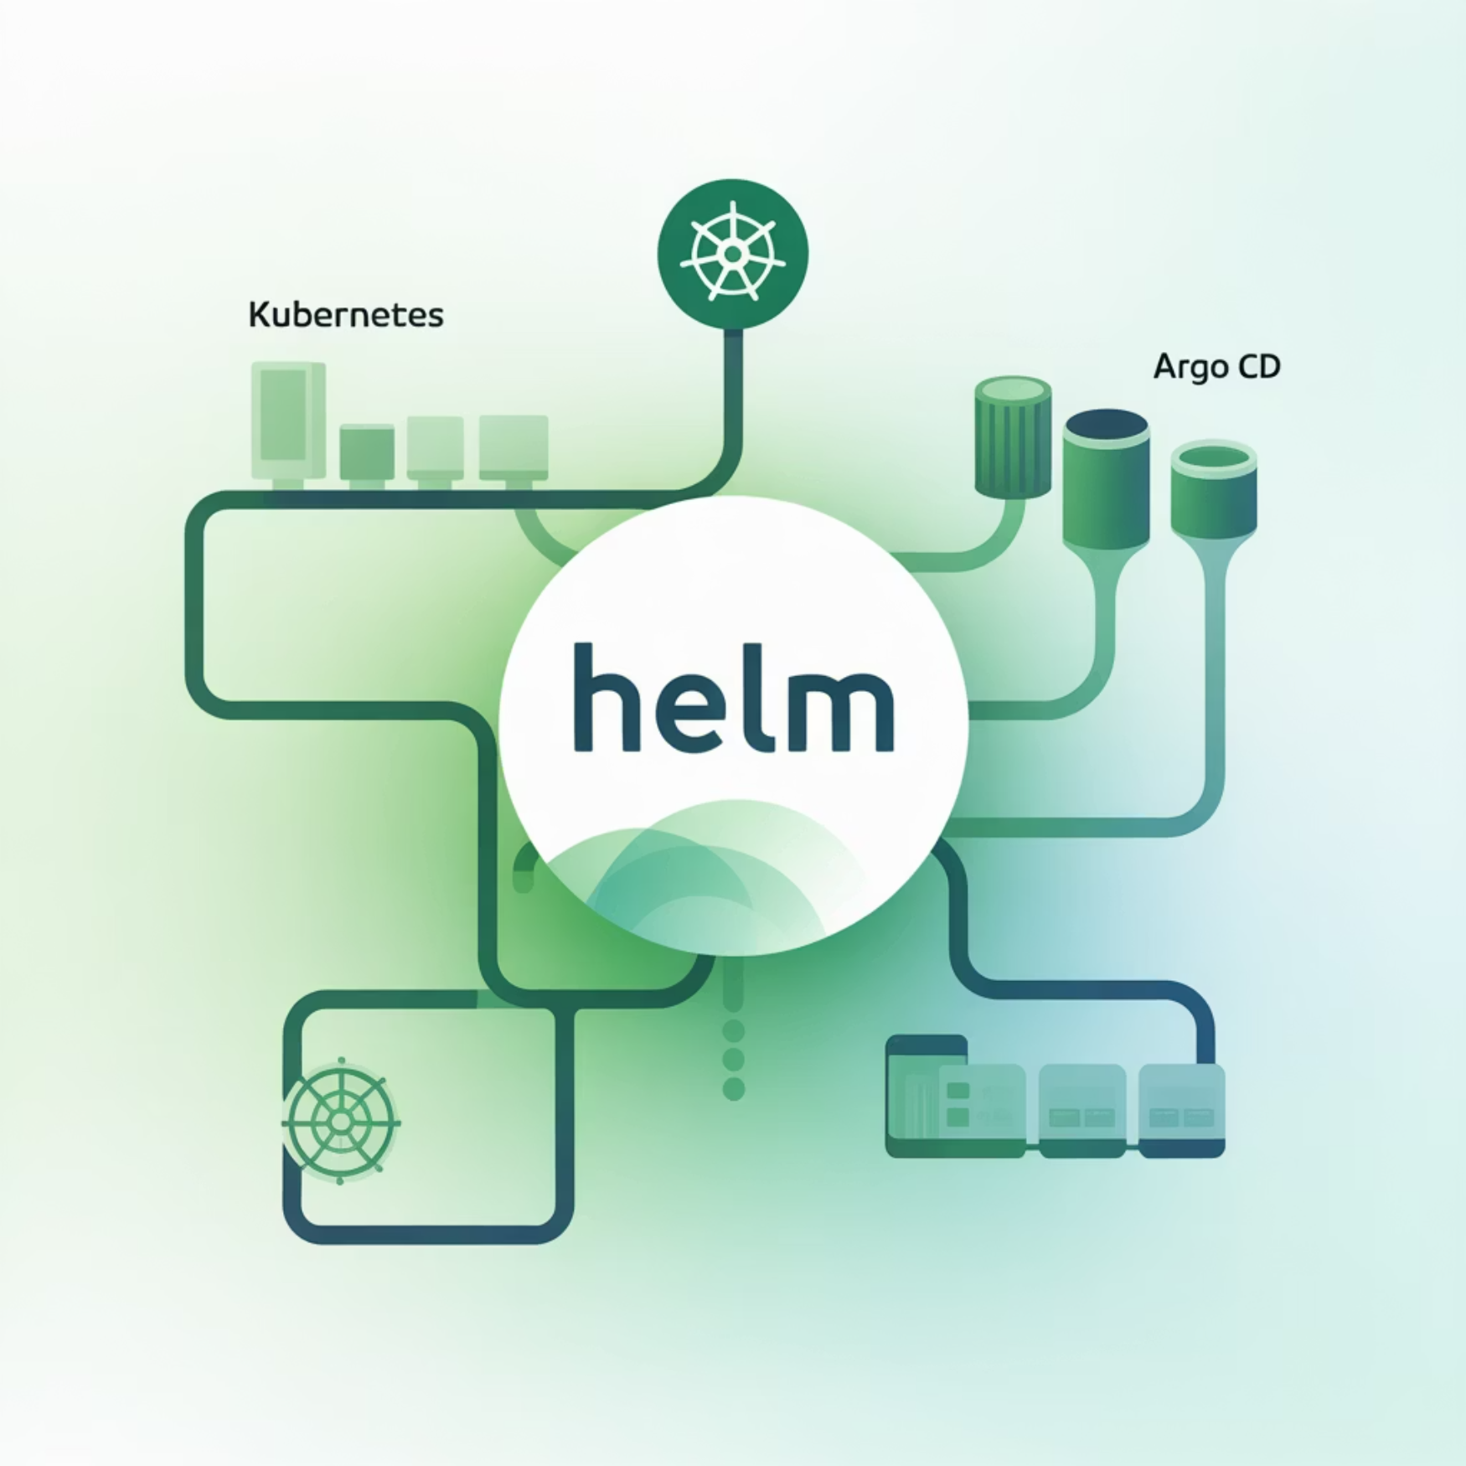
Additional Installation Methods
Kustomize Installation
Helm Installation
Install Argo CD manifests using Kustomize:
Argo CD can also be installed via Helm chart. Open source community-maintained Helm charts are available at:
kind: Kustomizationnamespace: argocdresources:- https://raw.githubusercontent.com/argoproj/argo-cd/master/manifests/ha/install.yaml
argo-helm/charts/argo-cd
This method is ideal for organizations already using Helm for other Kubernetes deployments, providing a consistent installation approach.
Organizations should maintain the manifest as a remote resource and use Kustomize patches to apply customizations.

Slide 14


Best Practice: Separate Source Code and Configuration
Source Code Repository
Configuration Repository
Application code and business logic
Kubernetes manifests and deployment configs
Benefits of Separation:
More manageable repositories - modify one without affecting the other
Cleaner logs for auditing purposes - easier to trace Git history
Enhanced security - restrict access to source code and Kubernetes manifests
Support for different versioning and release cycles in microservices
Prevention of build job loops in automated CI pipelines

Slide 15
Best Practice: Choose the Right Number of Config Repos
Small Companies
Mid-sized Companies
Large Organizations
Don't rely heavily on automation
Use some automation
Require greater control
All employees are trusted
Multiple teams with different needs
Rely significantly on automation
Recommendation: Use a mono-repo
Recommendation: One repository per team
Recommendation: One repository per service
Teams can often manage themselves better with their own repository, deciding who has release access without creating central bottlenecks.

Slide 16

Best Practice: Test Manifests Before Committing
Why Test Before Committing?
Prevents introduction of issues into pre-production environments
Reduces failed deployments and troubleshooting time
Improves overall stability of the GitOps workflow
Testing Approach:
Run commands locally to test manifests before committing changes
Validate Helm charts or other templates used to generate manifests
Ensure syntax and semantic correctness before pushing to the repository

Slide 17
Best Practice: Prevent External Changes to Manifests
The Configuration Drift Problem:
Ad-hoc commands outside the CI/CD process cause configuration drift
Drift impacts application deployments - apps may pass in staging but fail in production
Changes made directly with kubectl bypass the GitOps workflow
How Argo CD Helps:
Uses Git as a single source of truth for all deployments
Maintains state traceability through Git history
Detects and marks applications as OutOfSync when direct changes are made
Offers auto-sync capability to eliminate configuration drift
Important: Ensure all manifest changes are committed to the Git repository to maintain a clean history.

Slide 18






Argo CD in the GitOps Ecosystem
CI Tools
Argo CD
Build artifacts and update manifests
Syncs Git state to clusters
Git Repos
Container Registry
Kubernetes & Monitoring
Store manifests, charts, and configs
Host built container images
Run apps and observe health
Argo CD works seamlessly with existing tools in your ecosystem, leveraging investments in declarative configurations based on YAML, Helm charts, Kustomize, or other systems rather than replacing them.

Slide 19



Related Argo Projects
Argo Rollouts
Argo Workflows
Argo Events
Extends Kubernetes with advanced deployment capabilities like canary, blue-green, and progressive delivery strategies.
Container-native workflow engine for orchestrating parallel jobs on Kubernetes, useful for CI/CD, data processing, and machine learning.
Event-driven workflow automation framework for Kubernetes that helps you trigger workflows from a variety of events.
These projects complement Argo CD to provide a comprehensive GitOps platform for Kubernetes.

Slide 20
Summary: Why Choose Argo CD for GitOps
Kubernetes-Native
GitOps Automation
Configuration Drift Prevention
Purpose-built for Kubernetes, leveraging its controller pattern and extending its API
Automates the deployment process using Git as the single source of truth
Detects and remediates configuration drift to maintain system stability
Visualization & UI
Enterprise Readiness
Provides powerful visualization tools to understand application state
Supports multi-tenancy, RBAC, and high availability for production use
Argo CD simplifies Kubernetes GitOps implementation, making continuous deployment more reliable, traceable, and manageable.

